Slide 1







Analysis Of
YOUTUBE SONGS DATA
Using POWER BI

Slide 2


Learning Goals
1
2
3
Interactive Power BI dashboards showcasing visualizations of YouTube song data trends.
Reports detailing channel and content analysis, temporal trends, and user engagement insights.
Recommendations for content creators and stakeholders to enhance YouTube song video performance.

Slide 3



A comprehensive analysis of YouTube songs data using Power BI.
The dataset contains key attributes such as video ID, channel title, title, description, tags, published date,
view count, like count, favorite count, comment count, video duration, video definition, and caption
details.
Defining the Dataset

Slide 4



Points to ponder
1. What song reached the most likes, comments or views?
2. How do they engage the viewer?
3. What are the frequent hours for posting the content?
4. What is the most used tag?
5. Frequent hours of most engagement
6. Finding the Year, month, Day & hour of a trending particular video

Slide 5

OVERVIEW
This project aims to conduct a comprehensive analysis of YouTube songs data using Power BI. Power BI is a business analytic service provided by Microsoft.
We have used Power BI to clean data, transformed data, added & deleted relevant columns according to the need of the Analysis.
The goal is to utilize Power BI to create insightful visualizations and reports that provide a deeper
understanding of YouTube songs' performance, popularity, and user engagement. The analysis aims to
uncover trends, preferences, and patterns in the data to aid content creators and stakeholders in
optimizing their YouTube song content.

Slide 6

Purpose of Analysis
This Analysis can be created for a variety of reasons. Their purpose might be:
To improve user engagement
to advertise a brand to viewers
to convey particular preferences of users to the channel owner
to create public interest & raise likes & views

Slide 7
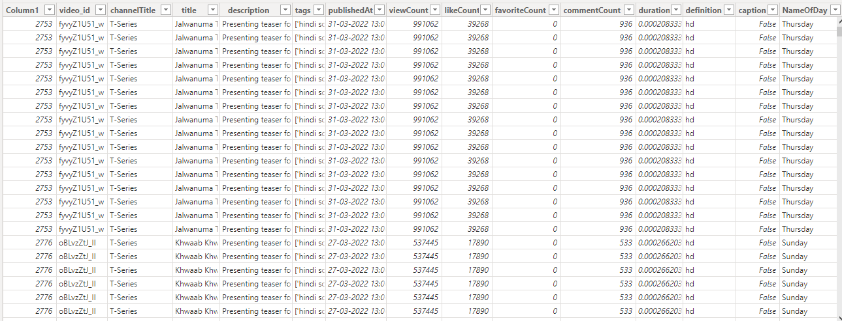

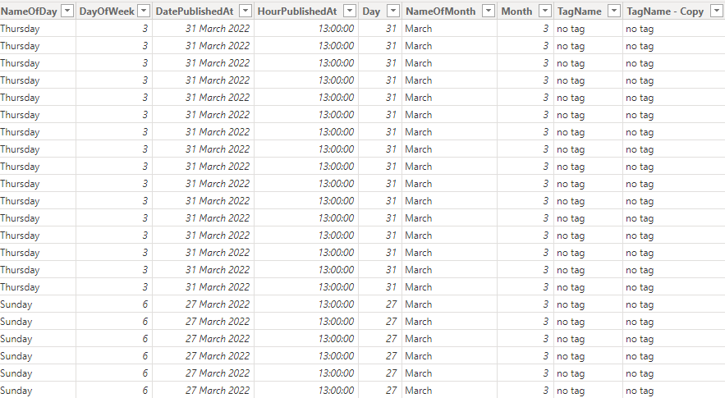
DATASET

Slide 8
DATASET DESCRIPTION
1. video_id: Unique identifier for each YouTube video.
2. channelTitle: Title of the YouTube channel publishing the song.
3. title: Title of the YouTube song video.
4. description: Description provided for the YouTube song video.
5. tags: Tags associated with the YouTube song video.
6. publishedAt: Date and time when the YouTube song video was published.
7. viewCount: Number of views received by the YouTube song video.
8. likeCount: Number of likes received by the YouTube song video.
9. favoriteCount: Number of times the YouTube song video has been marked as a favorite.
10. commentCount: Number of comments posted on the YouTube song video.
11. duration: Duration of the YouTube song video.
12. definition: Video definition or quality (e.g., HD, SD).
13. caption: Availability of captions for the YouTube song video.

Slide 9
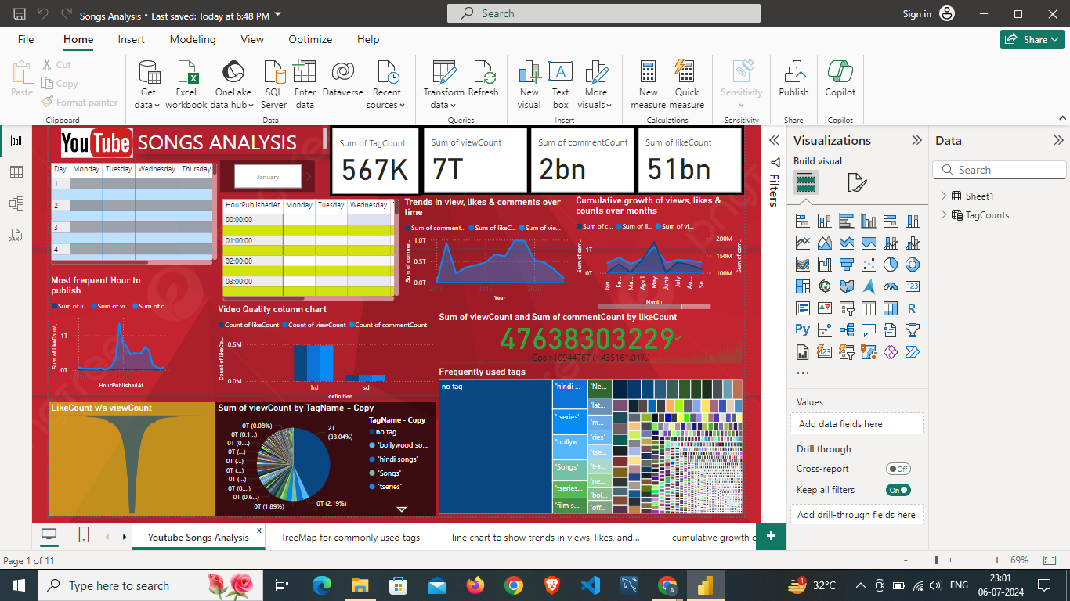

Slide 10
THANK
YOU!

